Slide 1
Can China become the world's leading economy?
(Minor attempt to predict unpredictable)
PhDr. Jan Ruzicka, MBA

Slide 2
Past

Slide 3
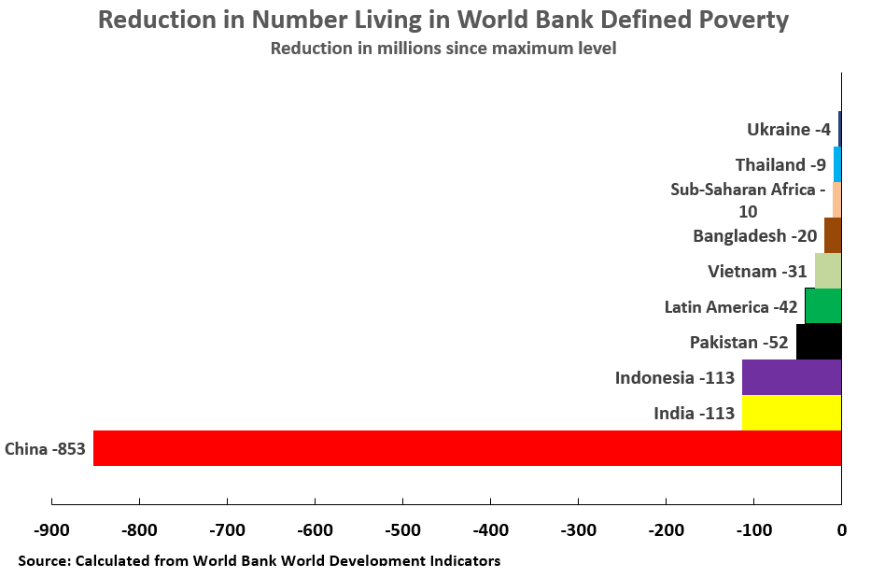

Slide 4
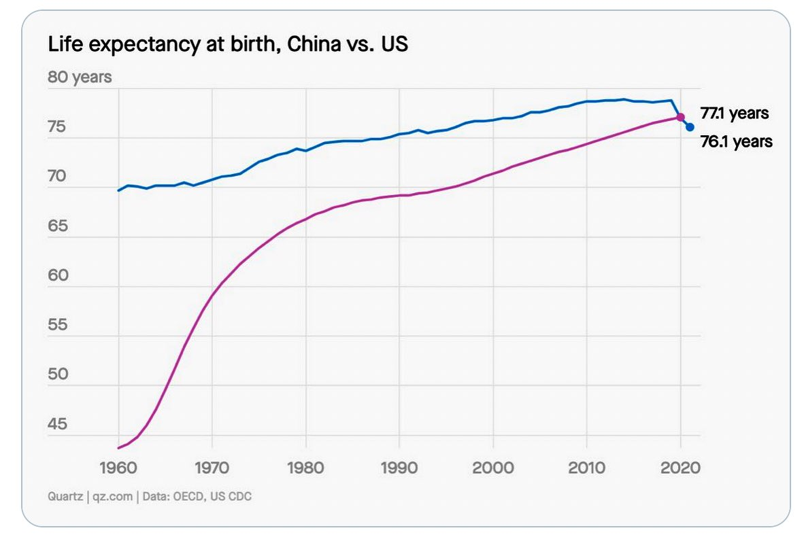

Slide 5
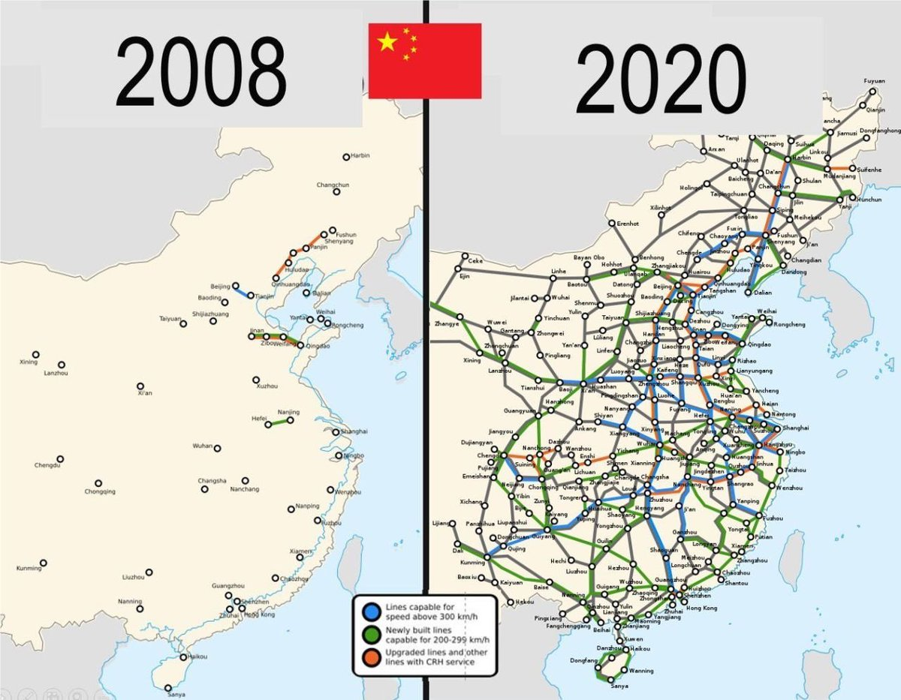

Slide 6
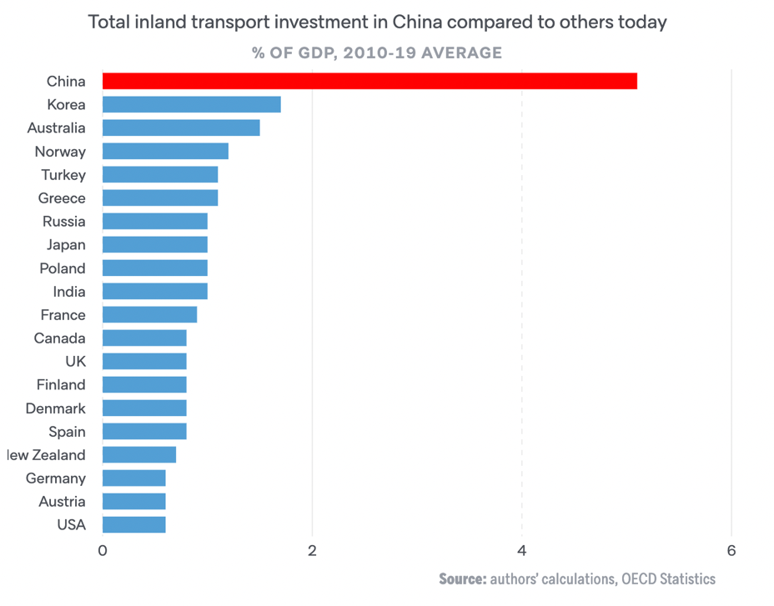

Slide 7
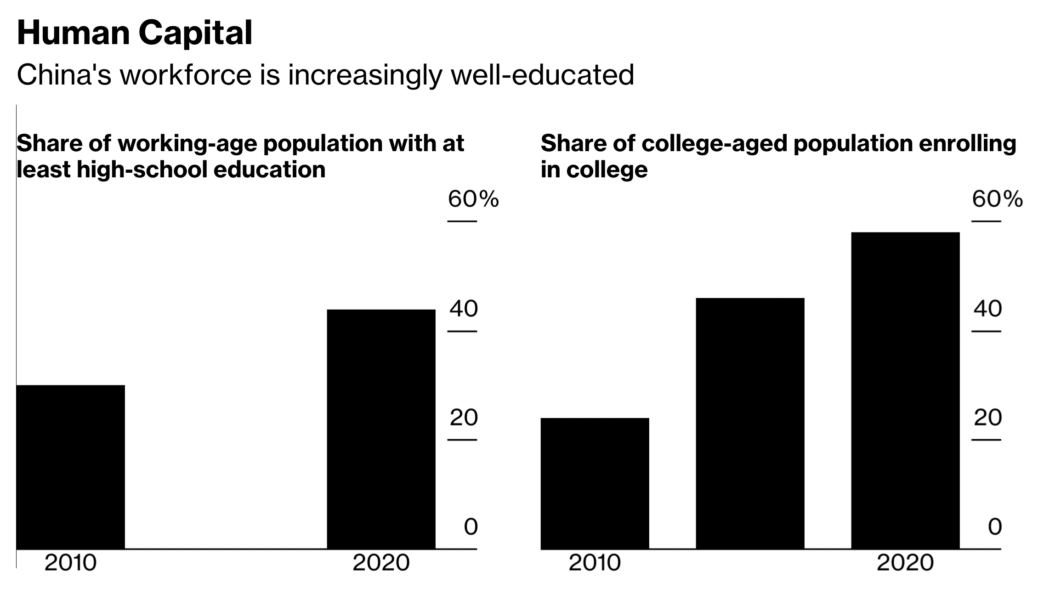

Slide 8
 | THE Ranking 2022
Oxford | 1
CalTech | 2
Harvard | 3
Stanford | 4
Cambridge | 5
Columbia | 11
Peking University | 16
Tsinghua University | 16
Chinese University of Hong Kong | 49
Fudan University | 60
HK University of Science and Technology | 66
Zhejiang University | 75
Shanghai Jiao Tong | 84
University of Science and Technology of China | 88
Nanjing University | 105
Wuhan University | 157
SUSTech | 162
Charles University in Prague | 501-600

Slide 9
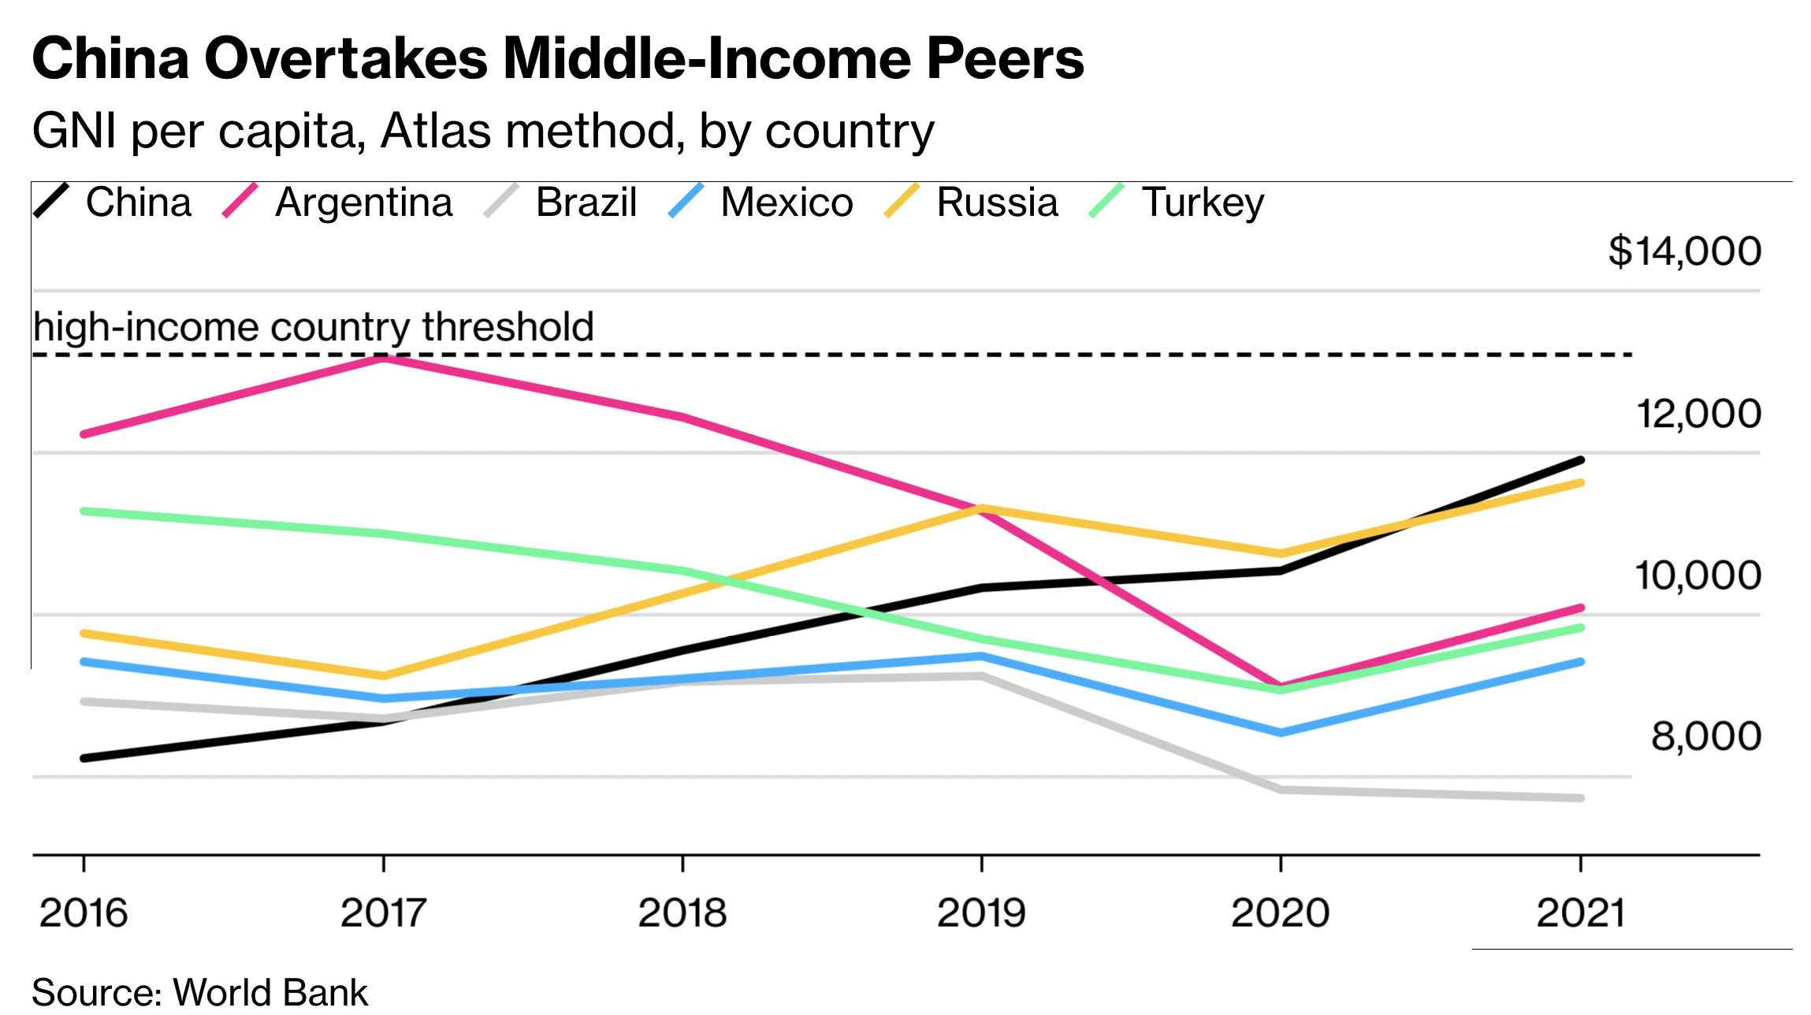

Slide 10
Present

Slide 11
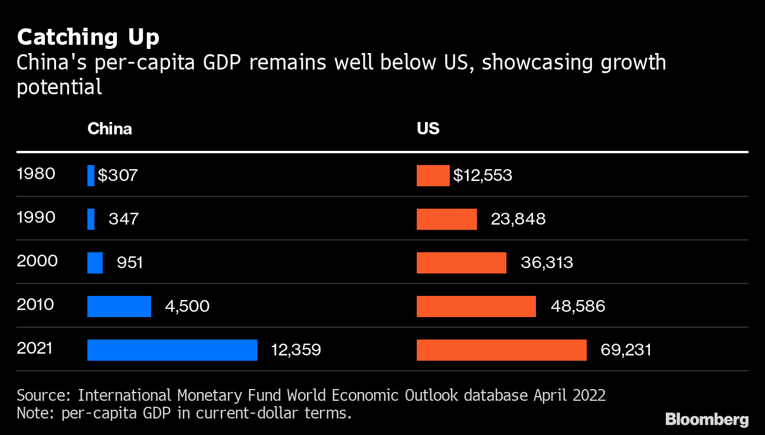

Slide 12
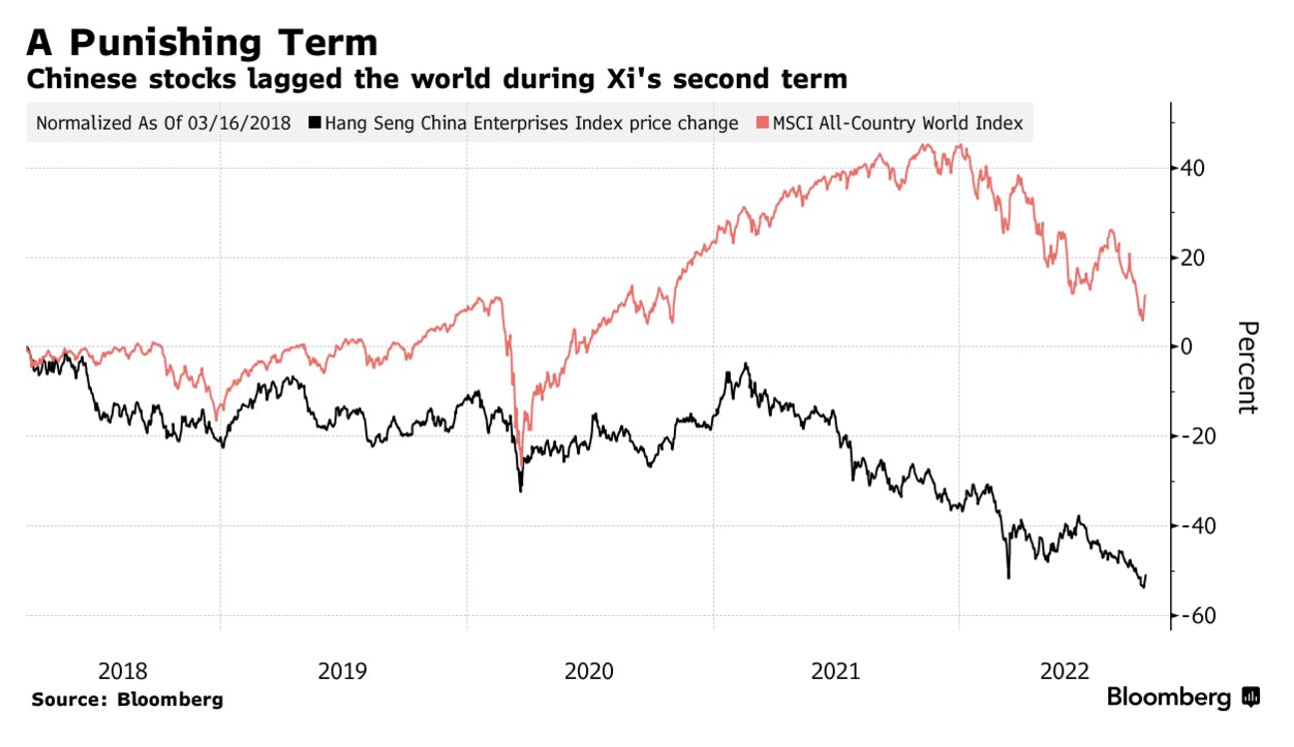

Slide 13
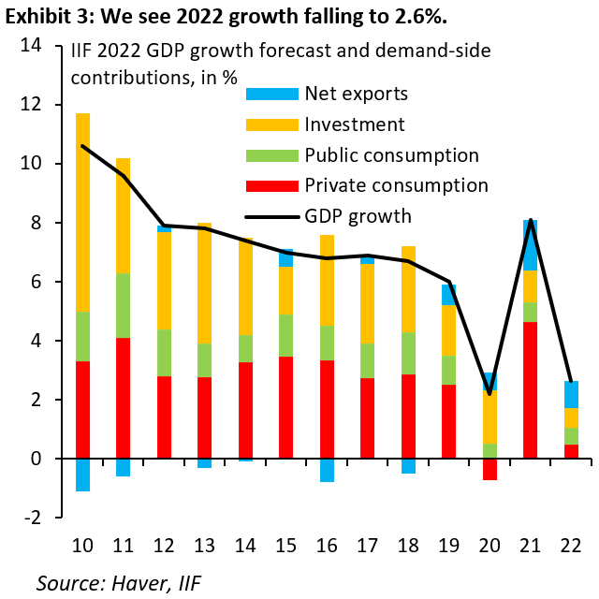

Slide 14
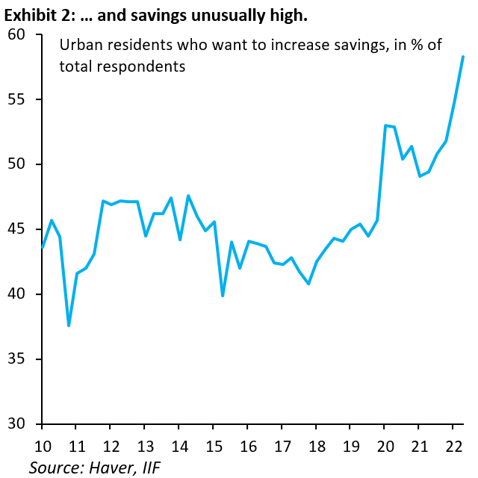

Slide 15
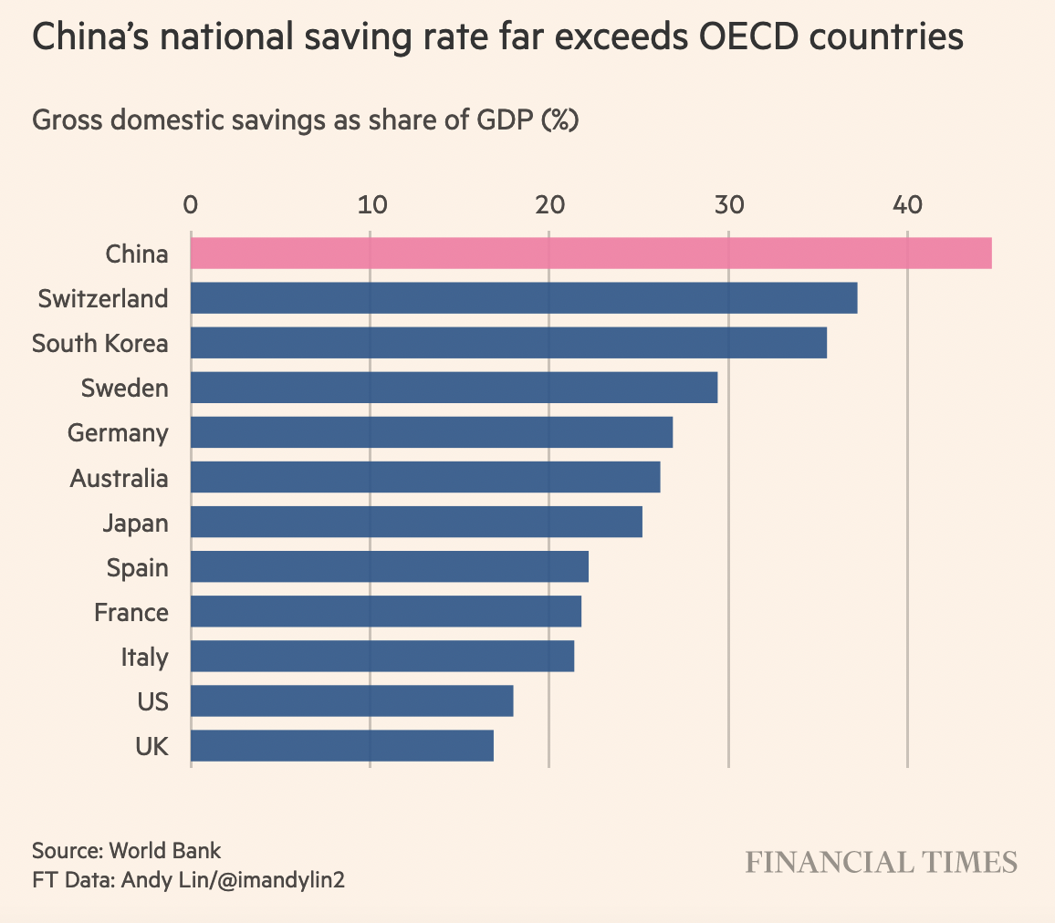

Slide 16
Future

Slide 17
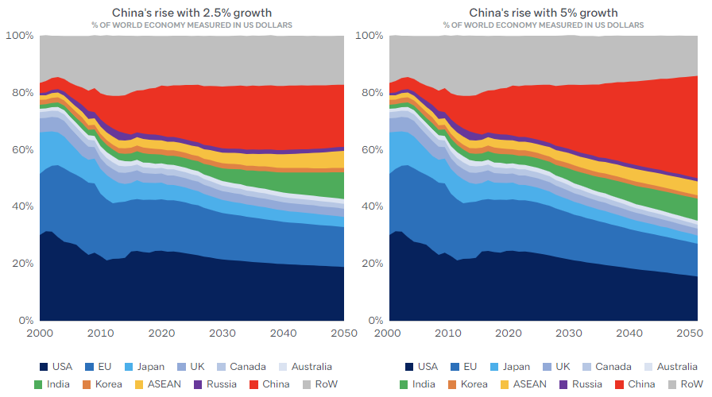

Slide 18
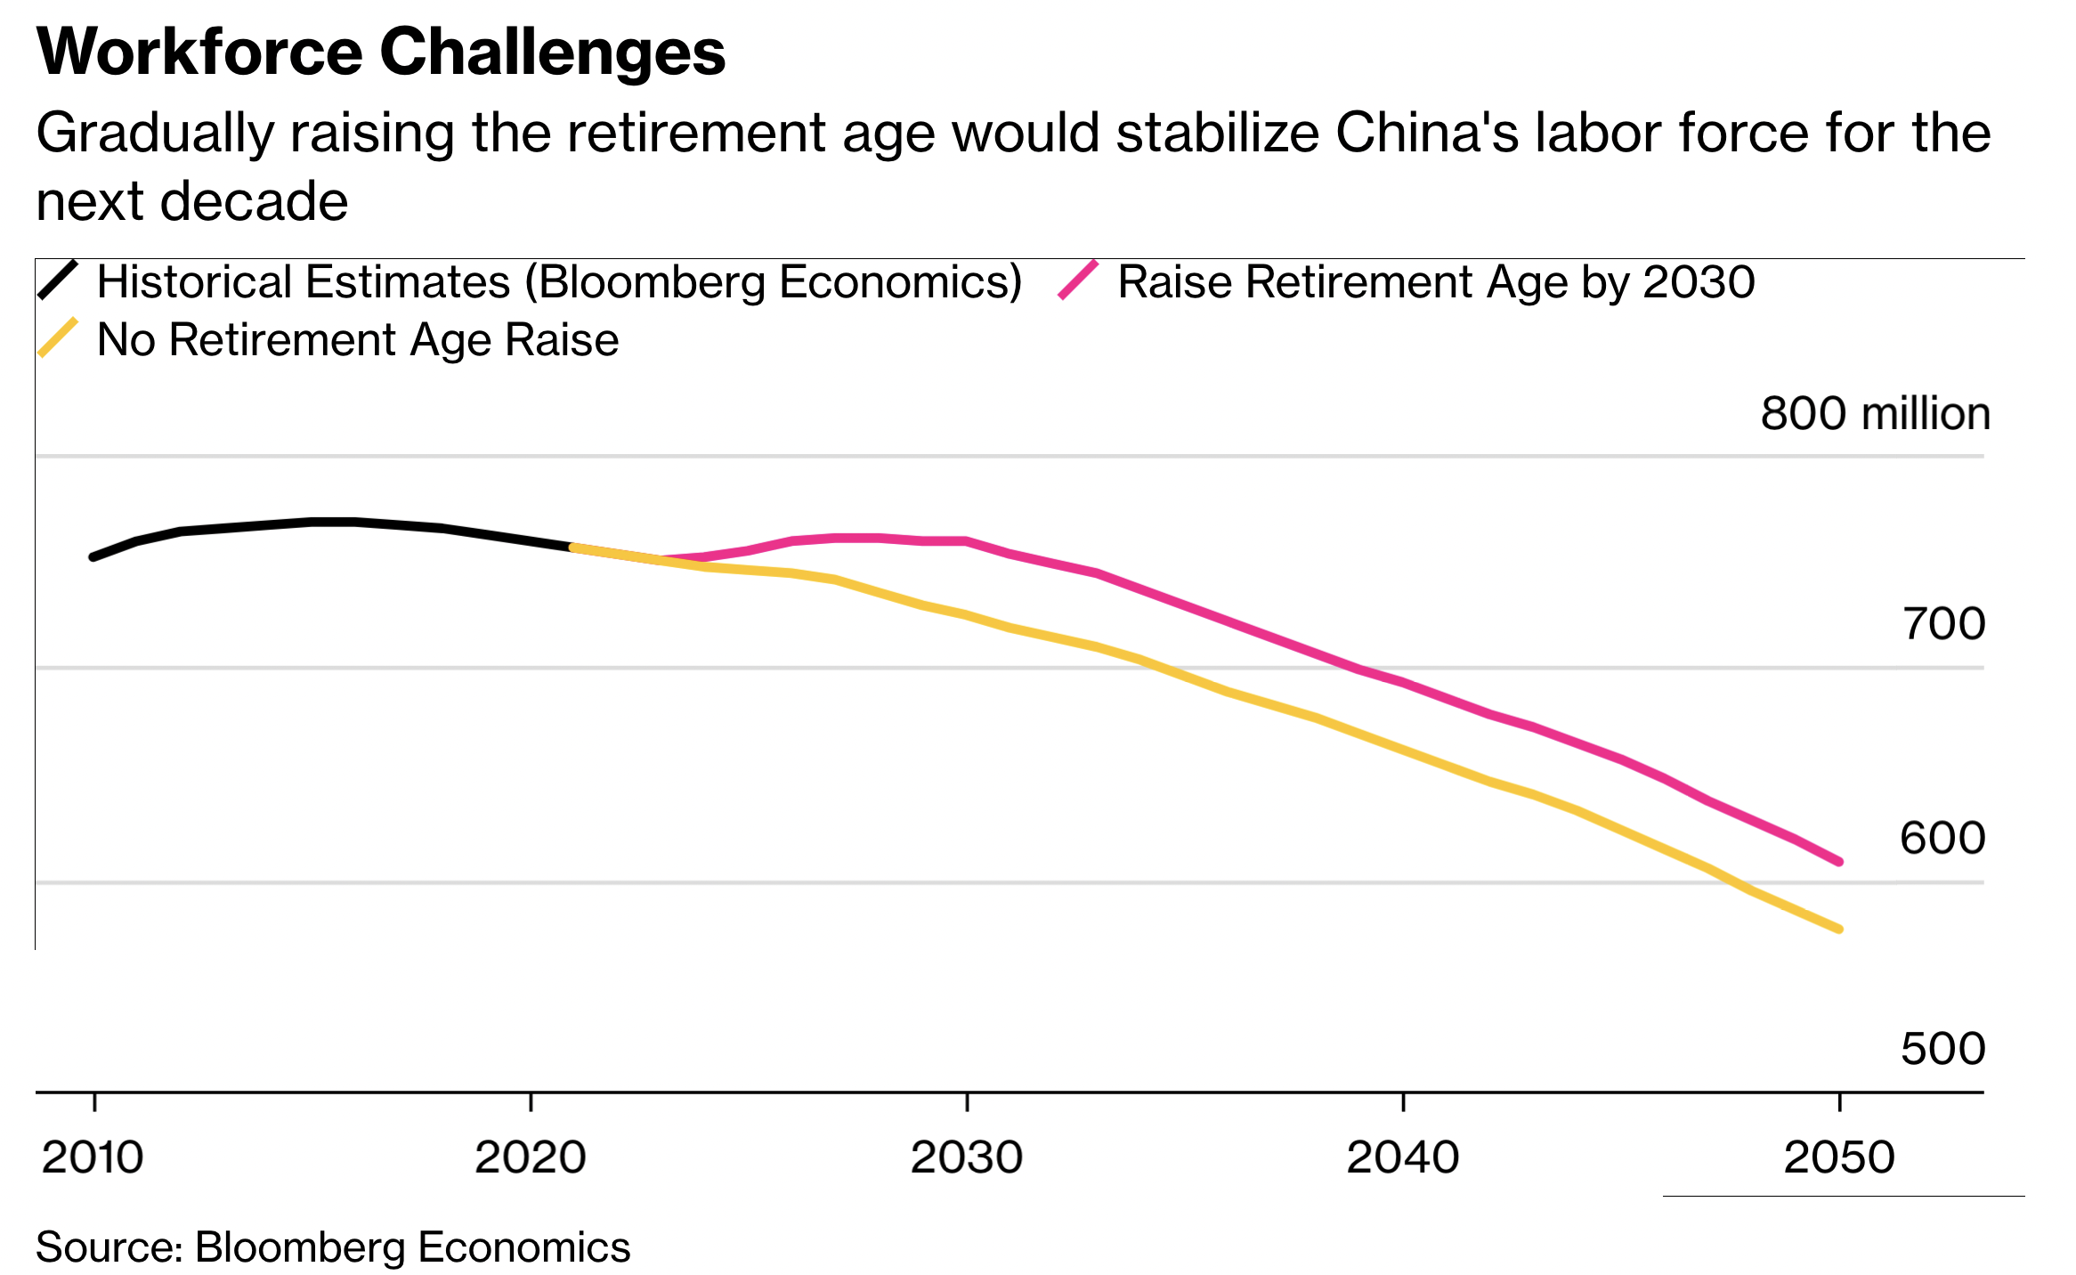

Slide 19
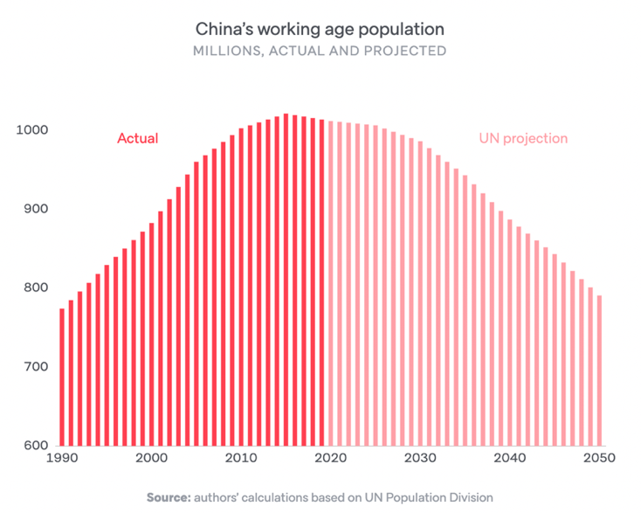

Slide 20
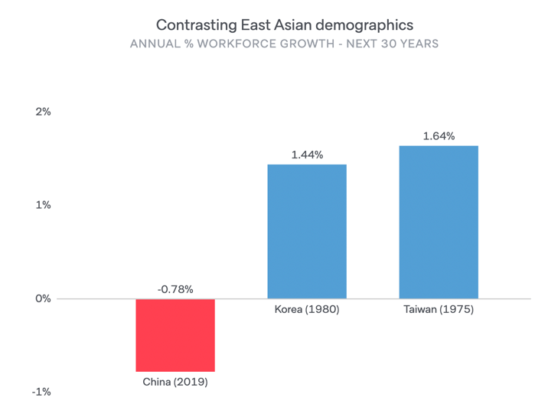

Slide 21
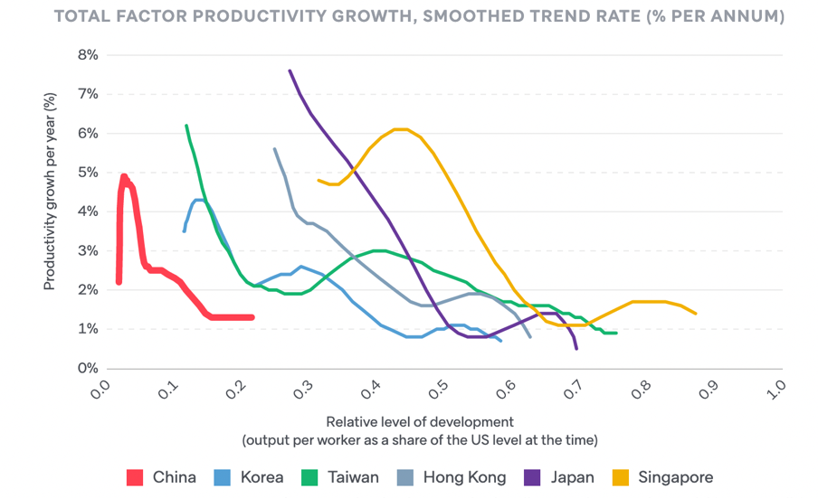

Slide 22
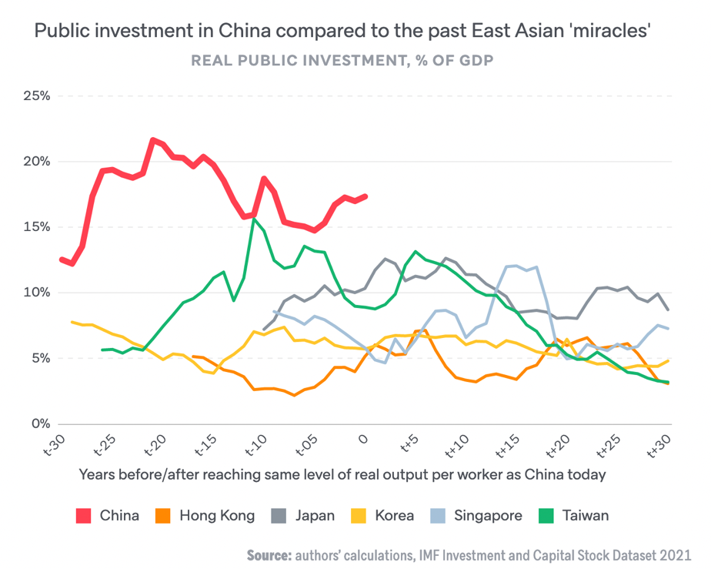

Slide 23
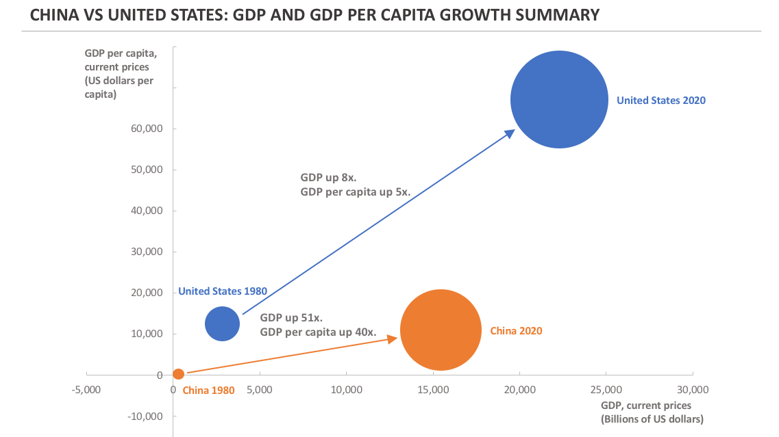

Slide 24
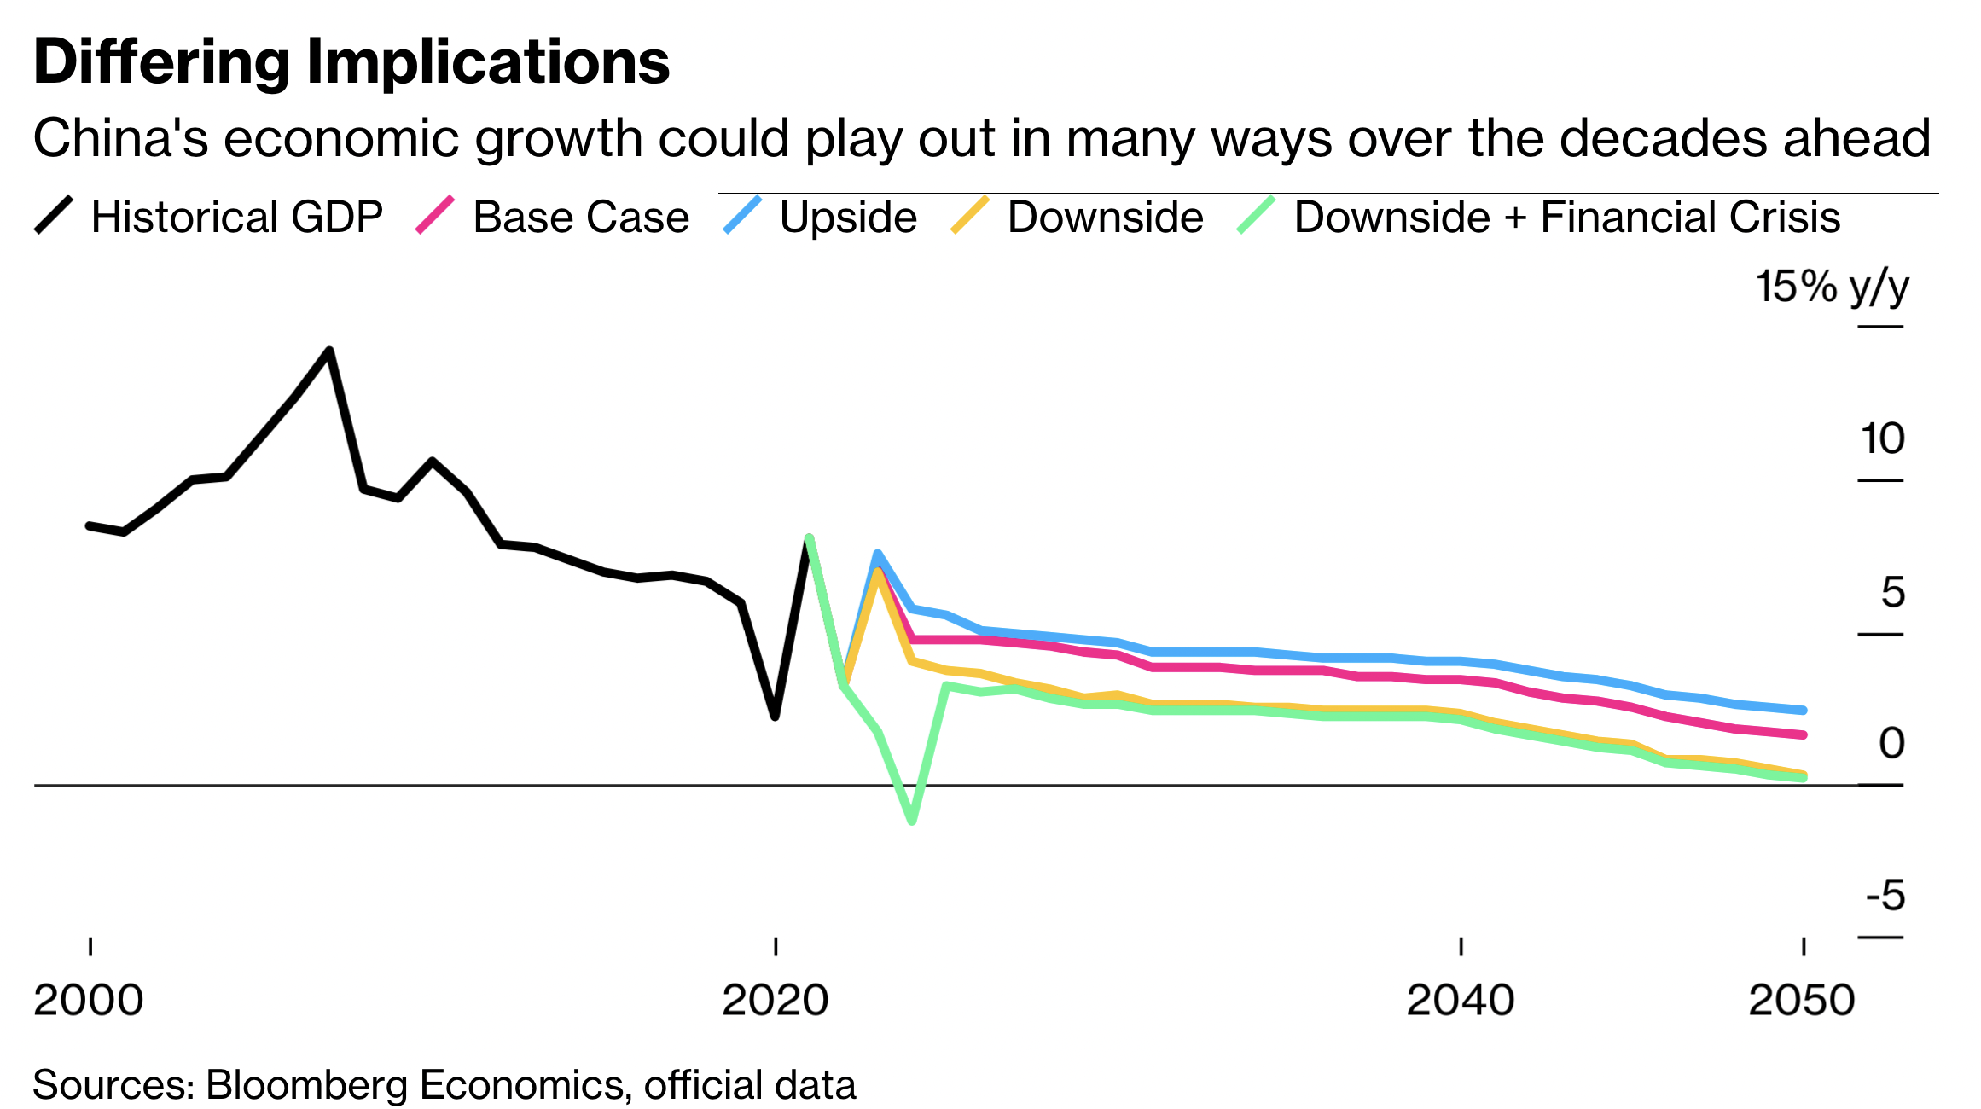

Slide 25
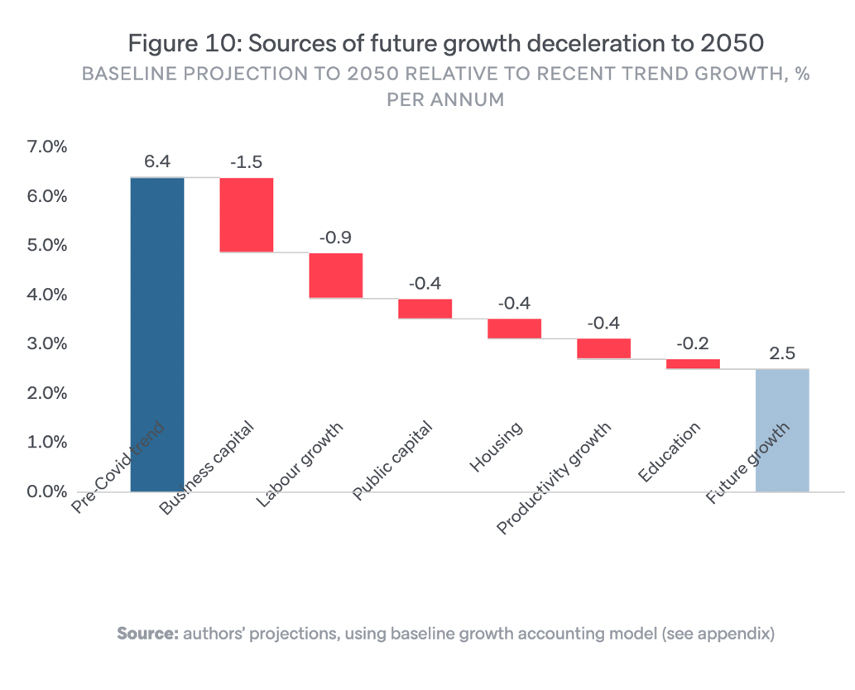

Slide 26
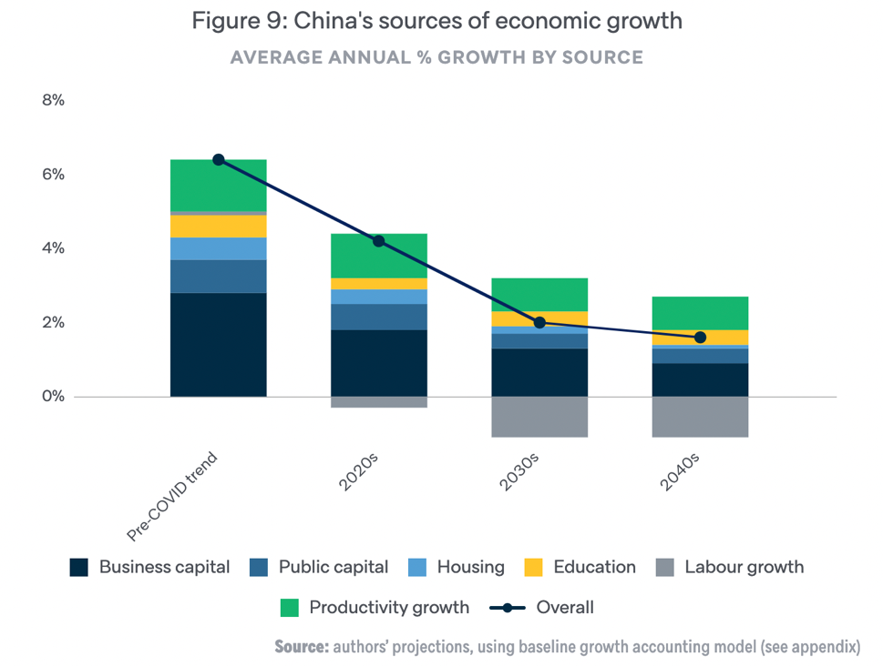

Slide 27
Summary
The rise of China is amongst the most globally significant developments of recent decades. China’s economic transformation means there are around 800M fewer people living in poverty. This is the biggest singular poverty alleviation success in human history.
China’s rise has also reshaped the global economy, and world politics. China is now the largest economy; it accounts for almost 20% of global production and it is no.1 trading partner for majority of countries and regions.
Geopolitically, China’s rise has brought America’s unipolar hegemony to an end, giving way to a new era of geostrategic rivalry that looks set to define international relations and global politics for decades.
However, will American unipolarity be transformed into Chinese one? No, I don’t believe that, and data don't support it. – Chinese economy is fighting middle income trap, slowing productivity, geopolitical headwinds and rapid ageing of the society which will shake labor market, real estate, health, and social system.
Although projected future Chinese GDP to slow, this is not predicated on China failing. Rather, the projections assume China continues to succeed. This success has a number: 3% GDP in upcoming decades. But it is not 5% or 7%, which means that Chinese own economic activity will never be able to take helm of the global economic system.
At the same time, we cannot go back, and multipolar world is our future. In this new world, China will be having place of comfortable no.2 and the US position of the strongest player but without ability to rule. Multipolarity is here.

Slide 28
Interesting read
Ronald Coase, How China became capitalist, Pallgrave 2012
Graham T. Allison, Can America and China Escape Thucydides's Trap?, Mariner Books 2017
Kerry Brown, CEO of China: The Rise of Xi Jinping, Tauris 2016
Henry Kissinger, On China, Penguin 2012
Lant Pritchett & Lawrence H. Summers, Asiaphoria meets regression to the mean, National Bureau of Economic Research 2014
Roland Rajah & Alyssa Leng, Revising down the rise of China, Lowy Institute 2022

Slide 29
Thanks for attention!

